Slide 1
Sprint Review
Basics of CSV, JSON & XML
By: Tori Larson

Slide 2
Birthday Data in R and Python.
Upload a CSV file?
Notes:
Originally started out doing birthday for work
Didn’t understand why I needed to use a csv file in R
So I decided to changed project to focus on CSV, JSON, and XML files

Slide 3
Comma,Separated,Values
FirstName,LastName,Birthday
Tori,Larson,5/26/2017
Ben,Trevino,4/14/2017
Justine,Espiritu,8/8/2017
Notes:
Continued to use birthday data
I started with CSV because it makes the most sense to me.
First row and all of the contents that go below it.

Slide 4
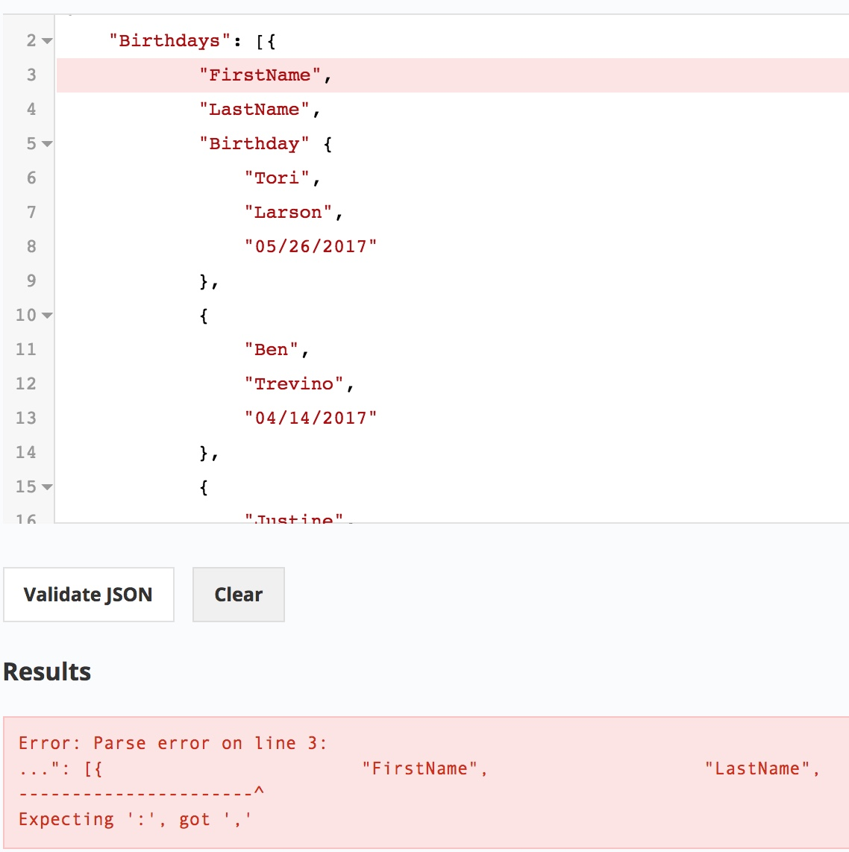
JSON
Exactly like CSV…..right?
{"Birthdays":[
{"FirstName", "LastName", "Birthday" {"Tori","Larson","05/26/2017"},
{"Ben", "Trevino","04/14/2017"}, {"Justine","Espiritu","07/28/2017"}
]}
Validate you JSON code here:
https://jsonlint.com/
Notes:
Then I moved to JSON.
Thought: its going to be exactly like CSV
Named it birthdays and did the row stacking like in a spreadsheet,
Found a cool website to validate all of it

Slide 5
JSON FINAL
{"Birthdays":[
{"FirstName": "Tori", "LastName": "Larson", "Birthday":"05/26/2017"},
{"FirstName": "Ben", "LastName": "Trevino", "Birthday": "04/14/2017"}, {"FirstName": "Justine", "LastName": "Espiritu", "Birthday": "07/28/2017"}
]}
Notes:
Here is the JSON final
They aren’t in a graph form but more in a hierarchal form
Each of them are in their own birthdays grouping

Slide 6
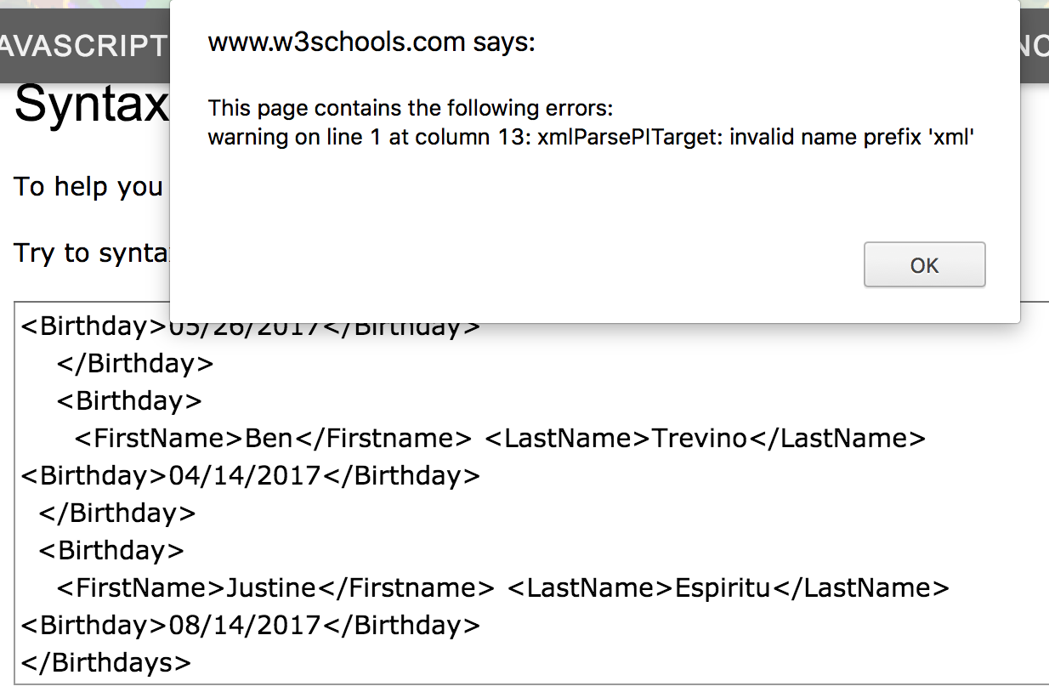
XML
<?xmlversion="1.0" encoding="UTF-8"?>
<Birthdays>
<Birthday>
<FirstName>Tori</Firstname>
<LastName>Larson</LastName> <Birthday>05/26/2017
</Birthday>
<Birthday>
<FirstName>Ben</Firstname> <LastName>Trevino</LastName> <Birthday>04/14/2017</Birthday>
</Birthday>
<Birthday>
<FirstName>Justine</Firstname> <LastName>Espiritu</LastName> <Birthday>08/14/2017</Birthday>
</Birthdays>
https://www.w3schools.com/xml/xml_validator.asp
Notes:
Moved on to XML
I looked up a lot of code of XML
You have to have the top row in order to signify it as an XML
Practiced with this a lot – put it in another validator

Slide 7
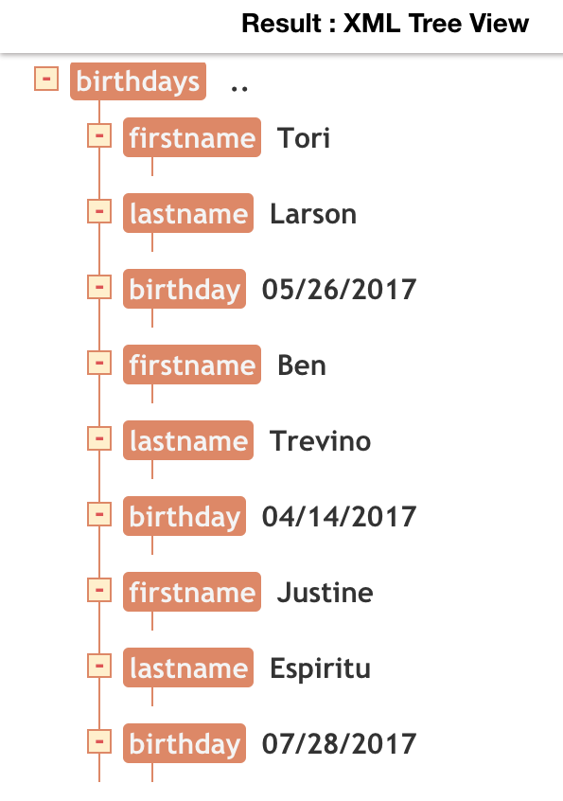
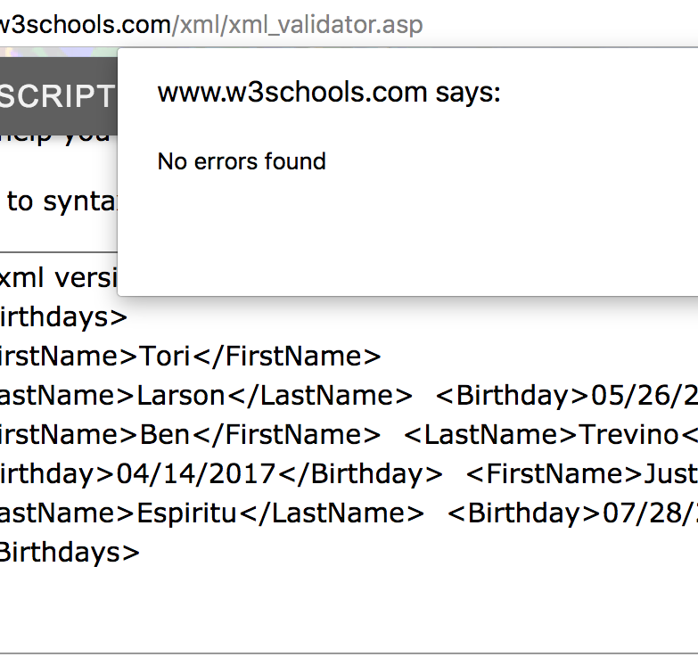
XML Tree
<?xml version="1.0" encoding= "UTF-8"?>
<Birthdays>
<FirstName>Tori</FirstName>
<LastName>Larson</LastName> <Birthday>05/26/2017</Birthday> <FirstName>Ben</FirstName> <LastName>Trevino</LastName> <Birthday>04/14/2017</Birthday> <FirstName>Justine</FirstName> <LastName>Espiritu</LastName> <Birthday>07/28/2017</Birthday>
</Birthdays>
https://codebeautify.org/xmlviewer
Notes:
Finally got it to read without errors
As I researched more I found that both JSON and XML are hierarchical formats.
I am very visual – wanted to see what the tree looked like.
Realized there was something wrong with my tree
I wanted each associate to be grouped into their own category

Slide 8
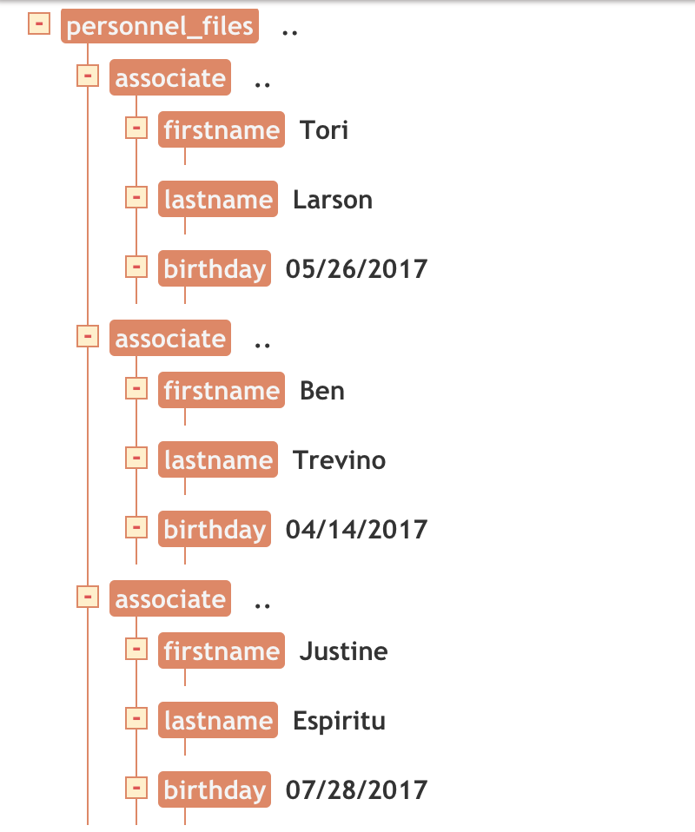
XML FINAL ATTEMPT WITH TREE
<?xml version="1.0" encoding= "UTF-8"?> <Personnel_Files>
<Associate>
<FirstName>Tori</FirstName> <LastName>Larson</LastName> <Birthday>05/26/2017</Birthday>
</Associate>
<Associate>
<FirstName>Ben</FirstName> <LastName>Trevino</LastName> <Birthday>04/14/2017</Birthday>
</Associate>
<Associate>
<FirstName>Justine</FirstName> <LastName>Espiritu</LastName> <Birthday>07/28/2017</Birthday>
</Associate>
</Personnel_Files>
Notes:
Final attempt
Here is my code and the tree I created

Slide 9
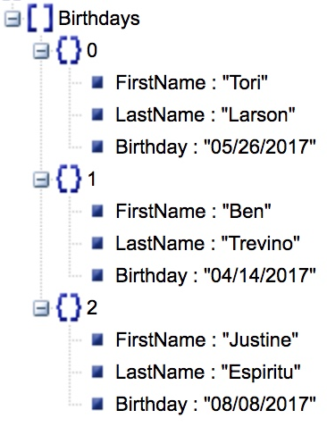
JSON TREE
{"Birthdays":[
{"FirstName": "Tori", "LastName": "Larson", "Birthday":"05/26/2017"},
{"FirstName": "Ben", "LastName": "Trevino", "Birthday": "04/14/2017"}, {"FirstName": "Justine", "LastName": "Espiritu", "Birthday": "07/28/2017"}
]}
Notes:
Then I wanted to see what a tree looked like in JSON
I would like to know if its possible to have them called something other than 0,1,2,3

Slide 10
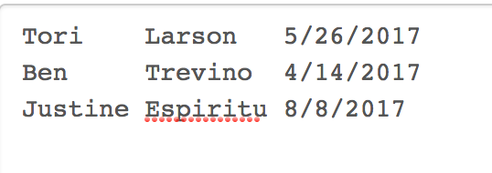
XML
JSON
CSV
Notes:
Three file types stacked next to each other – XML and JSON are hierarical
CSV is in more of a graph format

Slide 11
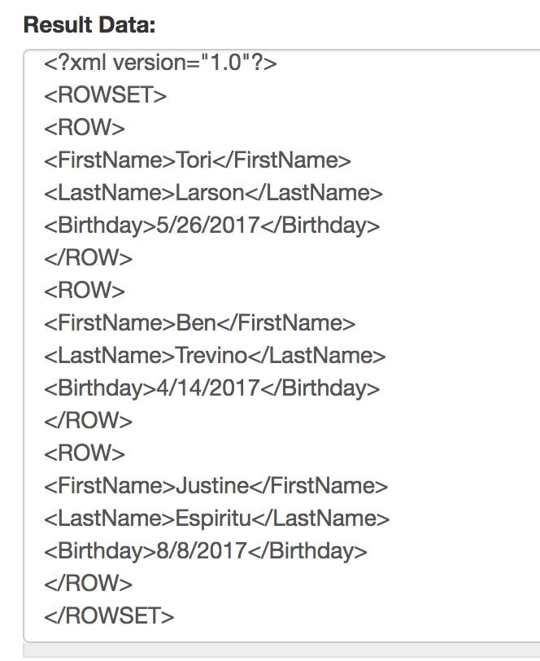
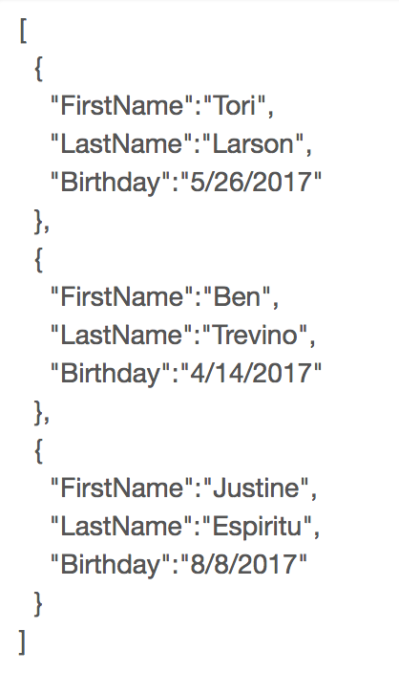
XML
JSON
<?xml version="1.0" encoding= "UTF-8"?> <Personnel_Files>
<Associate>
<FirstName>Tori</FirstName>
<LastName>Larson</LastName> <Birthday>05/26/2017</Birthday>
</Associate>
<Associate>
<FirstName>Ben</FirstName> <LastName>Trevino</LastName> <Birthday>04/14/2017</Birthday>
</Associate>
<Associate>
<FirstName>Justine</FirstName> <LastName>Espiritu</LastName> <Birthday>07/28/2017</Birthday>
</Associate>
</Personnel_Files>
{"Birthdays":[ {
"FirstName": "Tori", "LastName": "Larson", "Birthday":"05/26/2017”
},
{
"FirstName": "Ben", "LastName": "Trevino", "Birthday": "04/14/2017”
},
{
"FirstName": "Justine", "LastName": "Espiritu", "Birthday": "07/28/2017”
}
]}
http://www.becsv.com/csv-json.php
Notes:
Found this converting website
Convert CSV files to XML files and JSON files
Wanted to compare to see if I was visualizing the file types correctly.

Slide 12
The End

